Slide 1
Design Principles
Mahesh Shirole

Slide 2
What does it mean to be well designed?
A system that is well designed is easy to understand, easy to change, and easy to reuse
It presents no particular development difficulties, is simple and economical

Slide 3
Poor Design
The smells of a poor design have many different components
Rigidity: The system is hard to change because every time you change one thing, you have to change something else in a never ending succession of changes
Fragility: A change to one part of the system causes it to break in many other, completely unrelated, parts
Immobility: It is hard to disentangle the system into components that can be reused in other systems

Slide 4
Poor Design
The smells of a poor design have many different components
Viscosity: The development environment is held together with scotch tape and toothpaste. It takes forever to go around the edit, compile, test loop
Needless Complexity: There are lots of very clever code structures that aren’t actually necessary right now, but could be very useful one day
Needless Repetition: The code looks like it was written by two programmers named Cut and Paste

Slide 5
Design Principles
Open Close Principle (OCP)
Dependency Inversion Principle (DIP)
Interface Segregation Principle (ISP)
Single Responsibility Principle (SRP)
Liskov's Substitution Principle (LSP)

Slide 6
Open Close Principle (OCP)
Software entities like classes, modules and functions should be open for extension but closed for modifications
When referring to the classes, Open Close Principle can be ensured by use of Abstract Classes and concrete classes for implementing their behavior

Slide 7
OCP-Motivation
A clever application design and the code writing part should take care of the frequent changes that are done during the development and the maintaining phase of an application
Usually, many changes are involved when a new functionality is added to an application
Those changes in the existing code should be minimized, since it's assumed that the existing code is already unit tested and changes in already written code might affect the existing functionality in an unwanted manner
The Open Close Principle states that the design and writing of the code should be done in a way that new functionality should be added with minimum changes in the existing code
The design should be done in a way to allow the adding of new functionality as new classes, keeping as much as possible existing code unchanged

Slide 8
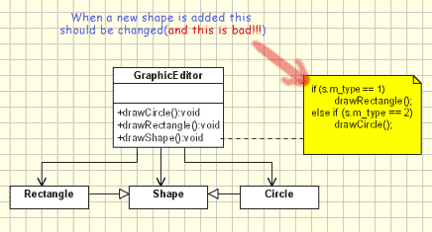
Example-Graphics Editor
Consider a graphic editor design example implements that handles the drawing of different shapes
What if need to add new shape Trangle?

Slide 9
Example-Graphics Editor
// Open-Close Principle - Bad example class GraphicEditor { public void drawShape(Shape s) { if (s.m_type==1) drawRectangle(s); else if (s.m_type==2) drawCircle(s); } public void drawCircle(Circle r) {....} public void drawRectangle(Rectangle r) {....} } class Shape { int m_type; } class Rectangle extends Shape { Rectangle() { super.m_type=1; } } class Circle extends Shape { Circle() { super.m_type=2; } }

Slide 10
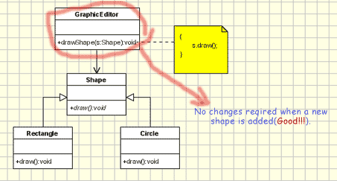
New Design-Graphics Editor
We can improve by using abstract draw() method in GraphicEditor for drawing objects
Move the implementation in the concrete shape objects
GraphicEditor is not changed when a new shape class is added

Slide 11
New Design-Graphics Editor
// Open-Close Principle - Good example class GraphicEditor { public void drawShape(Shape s) { s.draw(); } } class Shape { abstract void draw(); } class Rectangle extends Shape { public void draw() { // draw the rectangle } }

Slide 12
Dependency Inversion Principle
High-level modules should not depend on low-level modules
Both should depend on abstractions
Abstractions should not depend on details
Details should depend on abstractions

Slide 13
Motivation
When we design software applications we can consider the
low level classes the classes which implement basic and primary operations(disk access, network protocols,...) and
high level classes the classes which encapsulate complex logic(business flows, ...). The last ones rely on the low level classes.
A natural way of implementing such structures would be to write low level classes and once we have them to write the complex high level classes
Since high level classes are defined in terms of others this seems the logical way to do it. But this is not a flexible design
What happens if we need to replace a low level class?

Slide 14
Example
We have the manager class which is a high level class, and the low level class called Worker.
We need to add a new module to our application to model the changes in the company structure determined by the employment of new specialized workers
We created a new class SuperWorker for this
Let's assume the Manager class is quite complex, containing very complex logic
And now we have to change it in order to introduce the new SuperWorker

Slide 15
Example
// Dependency Inversion Principle - Bad example class Worker { public void work() { // ....working } } class Manager { Worker worker; public void setWorker(Worker w) { worker = w; } public void manage() { worker.work(); } } class SuperWorker { public void work() { //.... working much more } }

Slide 16
New Design - Example
In this new design a new abstraction layer is added through the IWorker Interface
Now the problems from the above code are solved(considering there is no change in the high level logic)
When this principle is applied it means the high level classes are not working directly with low level classes, they are using interfaces as an abstract layer
In this case instantiation of new low level objects inside the high level classes(if necessary) can not be done using the operator new (use creational design patterns)

Slide 17
Example
// Dependency Inversion Principle - Good example
interface IWorker { public void work(); } class Worker implements IWorker{ public void work() { // ....working } } class SuperWorker implements IWorker{ public void work() { //.... working much more } } class Manager { IWorker worker; public void setWorker(IWorker w) { worker = w; } public void manage() { worker.work(); } }

Slide 18
Interface Segregation Principle (ISP)
Clients should not be forced to depend upon interfaces that they don't use
The Interface Segregation Principle states that clients should not be forced to implement interfaces they don't use
Instead of one fat interface many small interfaces are preferred based on groups of methods, each one serving one sub-module

Slide 19
Motivation
When we design an application we should take care how we are going to make abstract a module which contains several sub-modules
Considering the module implemented by a class, we can have an abstraction of the system done in an interface
But if we want to extend our application adding another module that contains only some of the sub-modules of the original system, we are forced to implement the full interface and to write some dummy methods
Such an interface is named fat interface or polluted interface
Having an interface pollution is not a good solution and might induce inappropriate behavior in the system

Slide 20
Example
Below is an example which violates the Interface Segregation Principle
We have a Manager class which represent the person which manages the workers
We have 2 types of workers some average and some very efficient workers.
Both types of workers works and they need a daily launch break to eat.
But now some robots came in the company they work as well , but they don't eat so they don't need a launch break
One on side the new Robot class need to implement the IWorker interface because robots works
On the other side, the don't have to implement it because they don't eat

Slide 21
interface segregation principle - bad example
class Manager { IWorker worker; public void setWorker(IWorker w) { worker=w; } public void manage() { worker.work(); }}
class SuperWorker implements IWorker{ public void work() { //.... working much more } public void eat() { //.... eating in launch break } }
interface IWorker { public void work(); public void eat(); } class Worker implements IWorker{ public void work() { // ....working } public void eat() { // ...... eating in launch break } }

Slide 22
New Design - Example
The new code support the Interface Segregation Principle
By splitting the IWorker interface in 2 different interfaces the new Robot class is no longer forced to implement the eat method
Also if we need another functionality for the robot like recharging we create another interface IRechargeble with a method recharge

Slide 23
interface segregation principle - good example
interface IWorkable { public void work(); }
interface IResearchable extends IWorkable {
public void recharge(); }
interface Ifeedable extends IWorkable { public void eat(); }
class Manager { IWorkable worker; public void setWorker(Workable w) { worker=w; } public void manage() { worker.work(); } }
class Worker implements IFeedable{ public void work() { // ....working } public void eat() { //.... eating in launch break} }
class SuperWorker implements IFeedable{ public void work() { //.... working much more } public void eat() { //.... eating in launch break } }
class Robot implements IRechargable{ public void work() {// ....working }
Public void recharge(){ //…recharge } }

Slide 24
Single Responsibility Principle
A class should have only one reason to change
In this context a responsibility is considered to be one reason to change
This principle states that
if we have 2 reasons to change for a class
we have to split the functionality in two classes

Slide 25
Motivation
In this context, a responsibility is considered to be one reason to change
This principle states that if we have 2 reasons to change for a class, we have to split the functionality in two classes
Each class will handle only one responsibility and if in the future we need to make one change we are going to make it in the class which handles it
When we need to make a change in a class having more responsibilities the change might affect the other functionality related to the other responsibility of the class
The Single Responsibility Principle is a simple and intuitive principle, but in practice it is sometimes hard to get it right

Slide 26
single responsibility principle - bad example
Let's assume we need an object to keep an email message
We are going to use the IEmail interface from the below sample
interface IEmail { public void setSender(String sender); public void setReceiver(String receiver); public void setContent(String content); }
class Email implements IEmail { public void setSender(String sender) {// set sender; } public void setReceiver(String receiver) {// set receiver; } public void setContent(String content) {// set content; } }

Slide 27
Example
Let's assume we need an object to keep an email message
We are going to use the IEmail interface
At the first sight everything looks just fine.
At a closer look we can see that our IEmail interface and Email class have 2 responsibilities (reasons to change)
One would be the use of the class in some email protocols such as pop3 or imap
If other protocols must be supported the objects should be serialized in another manner and code should be added to support new protocols
Another one would be for the Content field
Even if content is a string maybe we want in the future to support HTML or other formats
If we keep only one class, each change for a responsibility might affect the other one:
Adding a new protocol will create the need to add code for parsing and serializing the content for each type of field
Adding a new content type (like html) make us to add code for each protocol implemented

Slide 28
New Design
We can create a new interface and class called IContent and Content to split the responsibilities
Having only one responsibility for each class give us a more flexible design:
adding a new protocol causes changes only in the Email class
adding a new type of content supported causes changes only in Content class

Slide 29
Improved code after SRP
interface IEmail { public void setSender(String sender); public void setReceiver(String receiver); public void setContent(IContent content); }
interface Content { public String getAsString(); // used for serialization }
class Email implements IEmail { public void setSender(String sender) {// set sender; } public void setReceiver(String receiver) {// set receiver; } public void setContent(IContent content) {// set content; } }

Slide 30
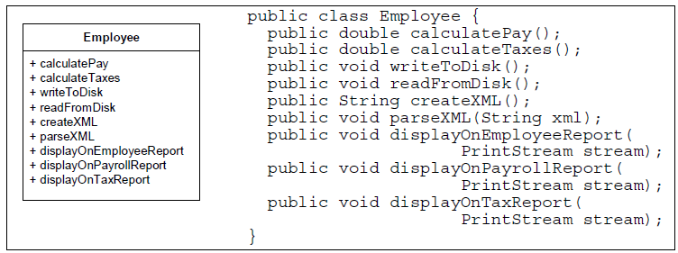
Example

Slide 31
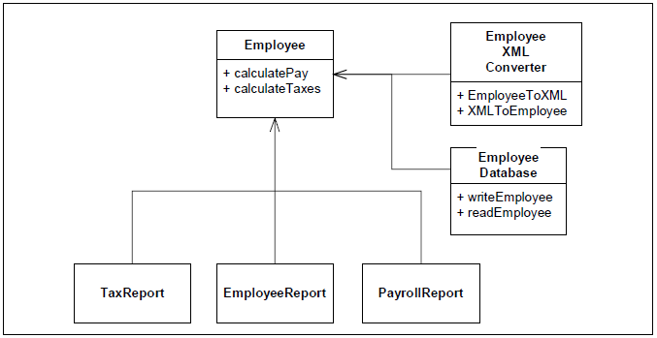
Example

Slide 32
Liskov's Substitution Principle(LSP)
All the time we design a program module and we create some class hierarchies
Then we extend some classes creating some derived classes
We must make sure that the new derived classes just extend without replacing the functionality of old classes
Otherwise the new classes can produce undesired effects when they are used in existing program modules
Likov's Substitution Principle states that
if a program module is using a Base class,
then the reference to the Base class can be replaced with a Derived class without affecting the functionality of the program module

Slide 33
Example
Below is the classic example for which the Liskov's Substitution Principle is violated
In the example 2 classes are used: Rectangle and Square
Let's assume that the Rectangle object is used somewhere in the application
We extend the application and add the Square class
The square class is returned by a factory pattern, based on some conditions and we don't know the exact what type of object will be returned
But we know it's a Rectangle
We get the rectangle object, set the width to 5 and height to 10 and get the area
For a rectangle with width 5 and height 10 the area should be 50
Instead the result will be 100

Slide 34
// Violation of Likov's Substitution Principle
class Rectangle { protected int m_width; protected int m_height;
public void setWidth(int width){ m_width = width; }
public void setHeight(int height){ m_height = height; }
public int getWidth(){ return m_width; }
public int getHeight(){ return m_height; }
public int getArea(){ return m_width * m_height; } }
class Square extends Rectangle {
public void setWidth(int width){ m_width = width;
m_height = width; }
public void setHeight(int height){ m_width = height; m_height = height; } }
class LspTest {
private static Rectangle getNewRectangle() {
// it can be an object returned by some factory ... return new Square(); }
public static void main (String args[]) {
Rectangle r = LspTest.getNewRectangle();
r.setWidth(5); r.setHeight(10);
// user knows that r it's a rectangle. It assumes that he's able to set the width and height as for the base class
System.out.println(r.getArea());
// now he's surprised to see that the area is 100 instead of 50.
} }

